Slide 1
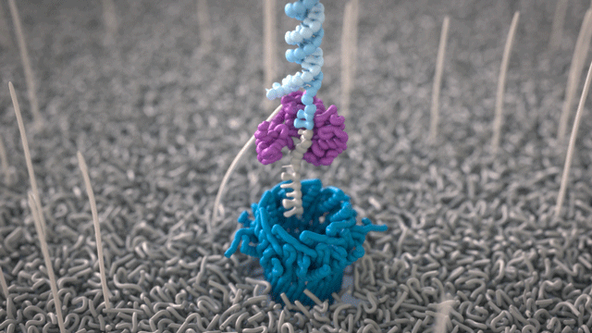

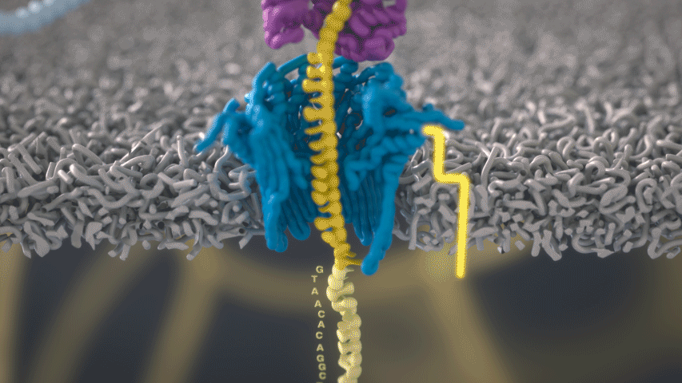
Introduction to ONT sequencing (Oxford Nanopore Technologies) (long read sequencing)
DNA sequencing | Oxford Nanopore Technologies

Slide 2
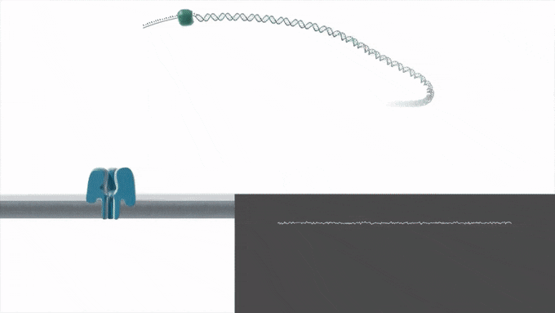
Nanopore sequencing is a unique, scalable technology that enables direct, real-time analysis of long DNA or RNA fragments. It works by monitoring changes to an electrical current as nucleic acids are passed through a protein nanopore. The resulting signal is decoded to provide the specific DNA or RNA sequence.
Direct DNA sequencing
The facility of nanopore technology to analyze native DNA, without the requirement for amplification, eliminates PCR bias and allows the identification of base modifications alongside nucleotide sequence — with no requirement for time-consuming, harsh, and often inefficient, chemical conversion (e.g. bisulfite conversion).

Slide 3
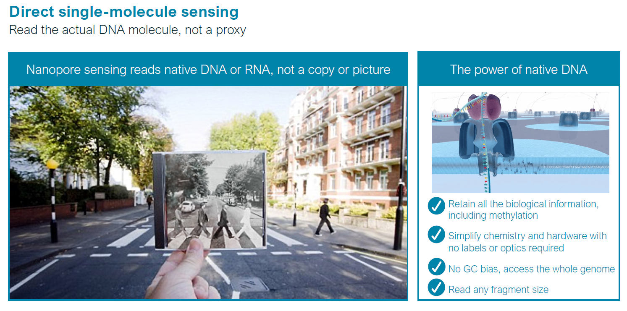
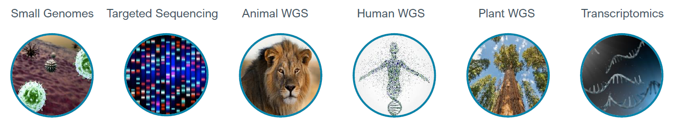

Slide 4
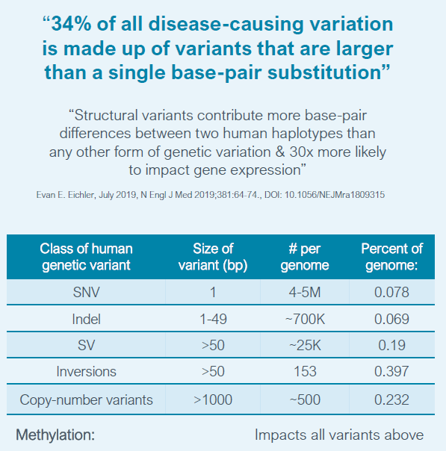
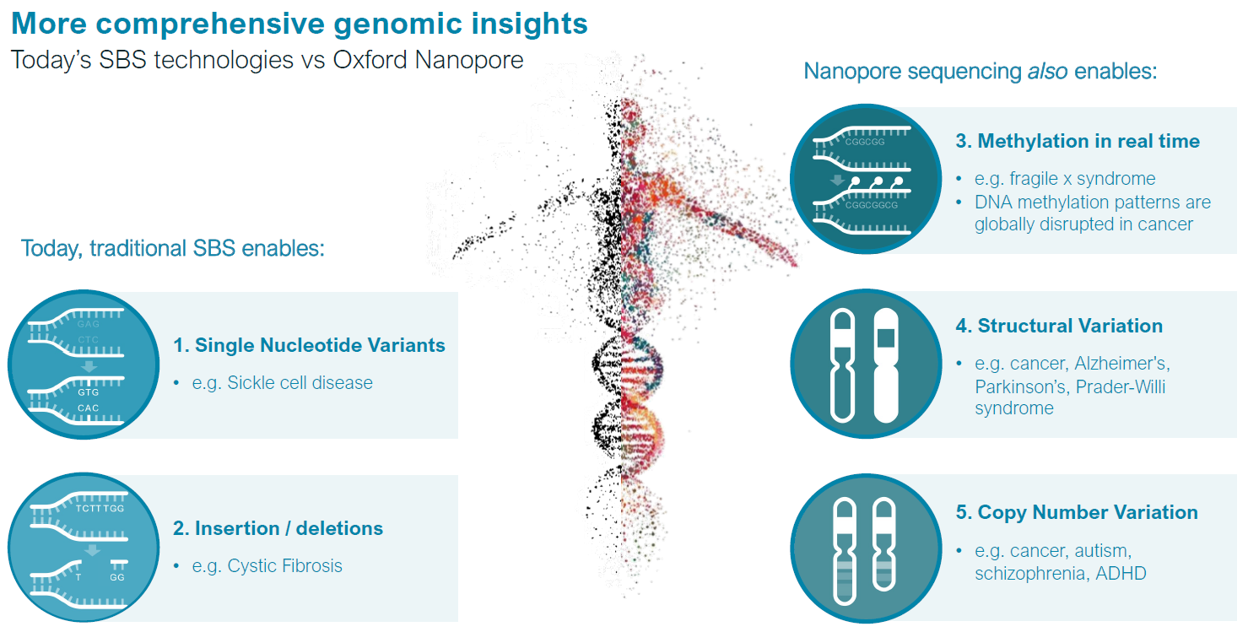
Genetic Variation, Comparative Genomics, and the Diagnosis of Disease - PMC (nih.gov)

Slide 5
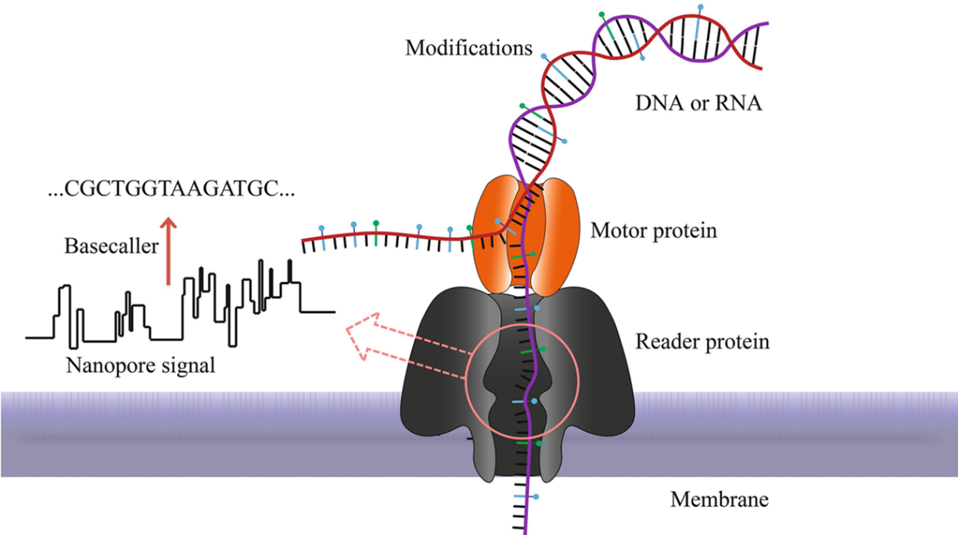
‘Long read’ technology
Nucleic acids are passed through a protein nanopore
As the different bases move through the nanopore, it creates a different electrical signal
These resulting changes in the electrical signal is decoded to provide the specific DNA or RNA sequence
..
..
....
..
..
....
..
..
....
..
..
....
..
..
....
..
..
..
..
..
....
..
..
..
Ionic current
Nanopore sequencers rely solely on the electrochemical structure of the different nucleotides for identification and measure the change in the ionic current as long strands of DNA (ssDNA) pass through the nano-scale protein pores.
Introduction to ONT (image credit) - https://link.springer.com/protocol/10.1007/978-1-0716-0868-5_9
https://nanoporetech.com/applications/dna-nanopore-sequencing

Slide 6
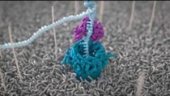
Video link: https://www.youtube.com/watch?v=RcP85JHLmnI&t=18s

Slide 7
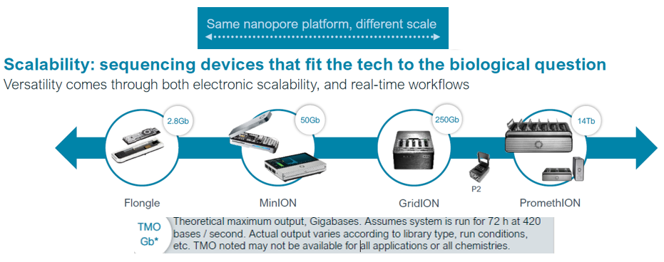
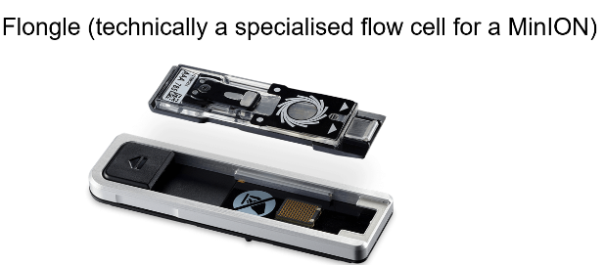
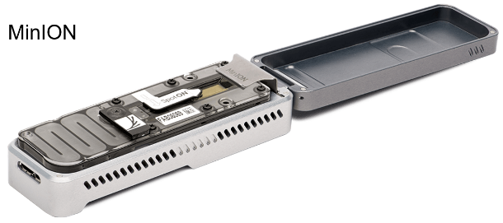
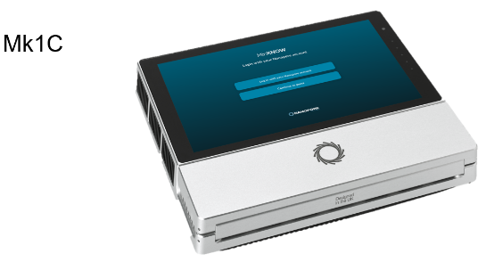
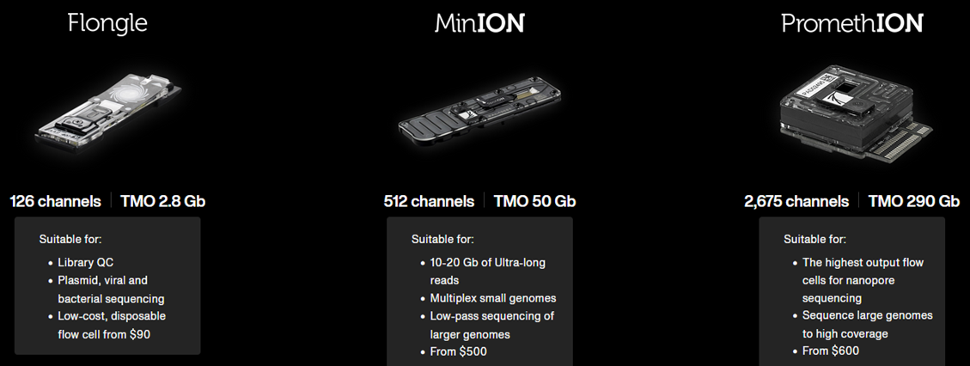
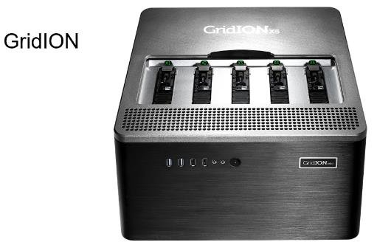
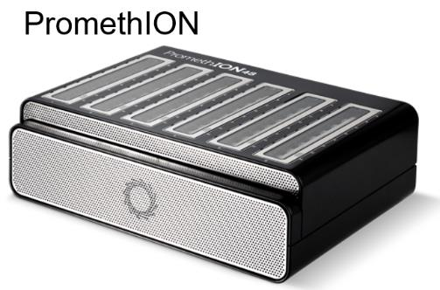
Different ‘library preparation’ kits and sequencing platforms can be used to sequence different things

Slide 8
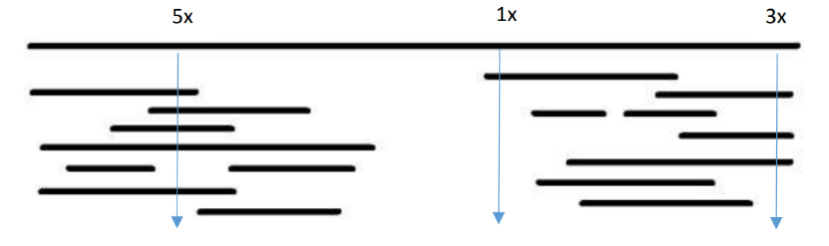
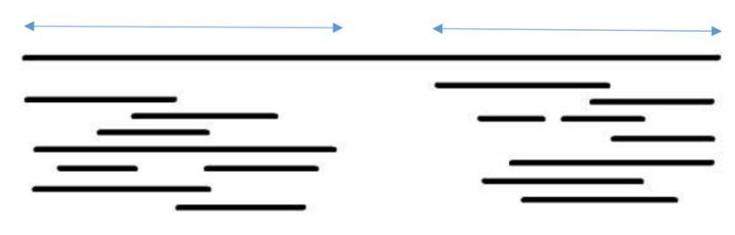
Why is getting so much information so important?
Depth and coverage are both very important when it comes to sequencing, but they mean different things.
Depth
This is the amount of times a base within a genome has been sequenced
The greater the depth, the greater the confidence in the identity of the sequenced base
In the image below, the complete reference genome is at the top. Below it are the sequenced contigs (a series of overlapping DNA fragments). Three bases are represented, which have varying depth of reads.
a physical map of the genome that is used to guide sequencing and assembly
a contig is an overlapping sequence data (reads)
Coverage
The percentage of the whole genome that has been sequenced.
For instance, in the example below, the sequenced contigs cover approximately 80% of the reference genome (at the top of the image), which means you would have sequenced 80% of the bases that make up the genome.
You will not be able to identify genes, SNPs etc. in parts of the genome that you do not have coverage for.

Slide 9
Pipeline and Current Tools to Process ONT Data
Step 1. Basecalling
Translates raw signal output of MinION/PromethION to generate DNA sequences.
Metrichor [1] (extracted with poretools [2]), nanonet [3], nanocall [4]
Step 2. Genome Assembly for noisy long reads
Using only the basecalled DNA reads, generates longer contiguous fragments called draft assemblies.
canu [5], miniasm [6]
Step 3. Polishing (Optional)
Generates an improved consensus sequence from the draft assembly
nanopolish [7], racon [8]

Slide 10
DNA Methylation Detection by
Basecalling your data and detecting methylation (nanoporetech.com)
Why is DNA Methylation Detection Important?
Epigenetics is key to understanding gene regulation.
DNA methylation detection is critical for understanding gene expression and regulation. Aberrant DNA methylation is associated with many diseases, including cancer, neurological disorders, and immune system dysfunction.
Accurate and efficient DNA methylation detection is essential for diagnosis and treatment.
Oxford Nanopore offers a new way of detecting DNA methylation.
How Does Oxford Nanopore Methylation Detection Work?
Oxford Nanopore's technology uses a nanopore sequencer to detect changes in electrical current as DNA passes through the pore.
This allows for real-time detection of DNA methylation.
The technology is fast and accurate, making it an attractive alternative to other methods of DNA methylation detection.

Slide 11
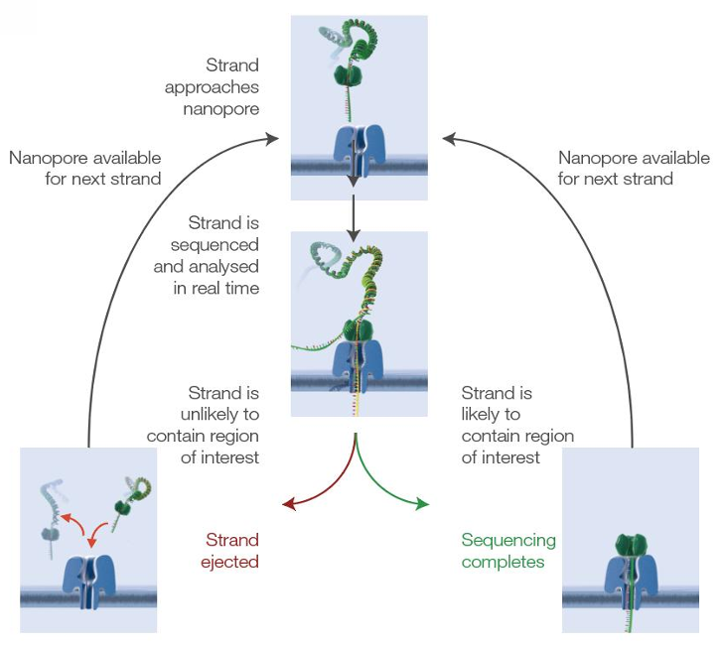
DevEpi Data
MiniION_ Adaptive sampling
c103
c104
PromethION_WGS
e4_WGS_E14.5_Cerebrum_WT
e7_WGS_E14.5_Cerebrum_Hom
What is Nanopore adaptive sampling?
Accept/reject molecules based on small initial part of sequence (~500 bp)
Enrich/deplete specific regions of interest.
Increase on-target data, reduce time-to answer.
Real time target selection: easy library preparation.
What Nanopore adaptive sampling offers?
Nanopore adaptive sampling is a simple, reliable, efficient and cost-saving approach.

Slide 12


to manipulate and visualize nanopore data stored in bam format
.bam
nanopore sequencing file for each sample
Basic plot
.gtf.gz
gencode annotation file for mm10 genome
Plotting by modbamtools
.bigwig
ChIP-seq file for H3K4me3
Plot with bigwig tracks
.txt/.bed
region of interest; chr18:36778332-37297840

Slide 13

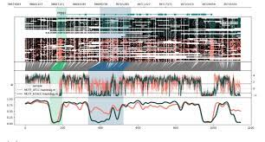
Tools for parsing and plotting methylation patterns from nanopore data
.bam
nanopore sequencing file for each sample
.gtf.gz
gencode annotation file for mm10 genome
Plotting by methylartist
Plot for methylation profile
genome.fa
reference mm10 genome
.txt/.bed
region of interest; chr18:36778332-37297840

